Slide 1
Optical Networks [EENGM0003]
Dr. George T. Kanellos
[gt.kanellos@bristol.ac.uk]

Slide 2
Part 2
Wavelength Division Multiplexing (WDM) Networks

Slide 3
Topics
Wavelength routing principles
Passive wavelength routing
Fixed Optical Add/Drop multiplexers
Static Optical cross connects

Slide 4
Wavelength Path
F
λ₂
C
C
C
λ₁
λ₂
E
E
E
λ₂
B
B
A
B
A
A
λ₂
λ₁
D
D
λ₁
D
Each optical path is assigned a single wavelength from end-to-end e.g. A-F, λ2
Wavelength reuse is possible, e.g. A-C, λ1 and B-E, λ1;
Wavelength blocking possible, the network management system must ensure this does not occur
Management system must look across whole network (to assign wavelengths), this can pose problems for large networks.

Slide 5
Virtual Wavelength Path
F
λ₂
C
C
C
λ₃
E
E
λ₁
E
B
B
A
B
λ₃
A
A
λ₂
D
D
λ₁
D
Wavelength translation at each node
Wavelength assigned link-by-link i.e. locally
Each optical path a concatenation of different wavelengths
Wavelength blocking eliminated
More complex nodes with possible transmission limitations

Slide 6
Necessity for Wavelength Conversion - Blocking
1
1
2
2
Wavelength routed networks: The channels are routed through the network according to wavelength
If a channel is blocking the path for another channel, wavelength conversion resolves blocking

Slide 7
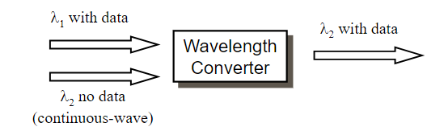
What is a Wavelength Converter?
o
u
t
p
u
t
s
i
g
n
a
i
l
n
p
u
t
s
i
g
n
a
l
@
@
λ
λ
2
1
w
a
v
e
l
e
n
g
t
h
c
o
n
v
e
r
t
e
r
It converts the wavelength of an optical channel to another wavelength, preserving the information encoded on the original input channel

Slide 8
Optical wavelength converters (OWC)
Multiple technologies are possible
Example : OWC based on SOA
λ_{s} : modulated input signal
λ_{p} : continuous wave (CW)
λ_{s} and λ_{p} interact due to FWM non-linear effect to generate new carriers :
FWM is transparent to the amplitude and to the phase of λs
Limitations : λs must be modulated at most 100 Gbit/s
Filter

Slide 9
SOA-MZI wavelength converter
Cross Phase Modulation (XPM)
XPM induces phase change to new wavelength
MZI interferometer translates phase change in amplitude modulation

Slide 10
WP vs VWP nodes
wavelength path
virtual wavelength path
space
space
λ conversion
switch
switch
demultiplexer
space switch
multiplexer
demultiplexer
space switch
wavelength translator
coupler

Slide 11
A WDM Ring Network
Main Features of Ring:
N(N-1)/2 wavelengths required to fully interconnect N nodes
Potential for high resilience

Slide 12
Example
WP
A→B: λ1
A→D: λ2
A→C: λ1
A→E:λ1
B→D: λ1
B→E:λ3
C→D: λ1
C→B: λ3
C→E:λ2
E→D: λ1
λ3
λ2
A
λ1
B
λ1
λ3
λ2
λ2
E
λ1
λ1
λ2
λ3
λ1
C
D
λ1
λ3
Can you design the network as a virtual wavelength path implementation?

Slide 13
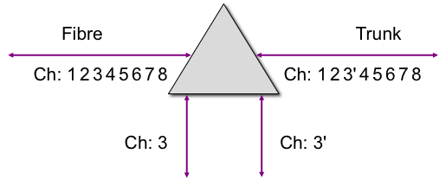
Grating Based Optical Add-Drop Multiplexer
λ₁
OADM
λ₁
MUX
OXC
λ con
λ_{N}
OADM
MUX
λ_{N}
Terminal
Terminal
Input ports
OADM
Output ports
Add
Drop
OADM
Single input fibre supporting multiple λ
Single output fibre supporting multiple λ
fixed
reconfigurable

Slide 14
Wavelength Add/Drop Multiplexers
Drop function
Add function
F
i
b
e
r
B
r
a
g
g
G
r
a
t
i
n
g
C
o
u
p
l
e
u
r
p
a
s
s
i
f
2
x
1
Passive coupler 2x1
O
A
D
M
Circulator
Circulator
FBG
S_{in}
S_{out}
FBG: Fibre Bragg Grating
Drop
Add

Slide 15
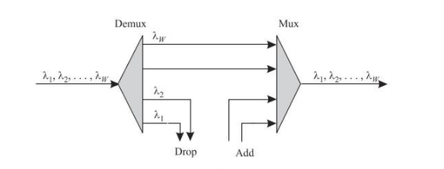
Static OADM I
Parallel architecture
All wavelengths are demultiplexed
Some wavelengths are terminated
Terminated wavelengths are preconfigured
Fixed losses
→Bidirectional

Slide 16
Optical Cross Connect (OXC)
λ₁
OADM
λ₁
MUX
OXC
λ con
λ_{N}
OADM
MUX
λ_{N}
Two basic switching schemes can be adopted in an OXC:
Space Switching
Either at the input or output to perform routing in the space domain
Wavelength Switching
Takes advantage of the WDM techniques:
Wavelength selection using passive devices
Wavelength conversion - solves blocking problem (when two input channels with the same wavelength aim at the same destination)

Slide 17
Optical Cross Connect (OXC)
WDM fibre
systems
demultiplexer
space switch
multiplexer
Add-drop ports
Dimensions: 32 fibres x 100 λ’s/fibre = 3200 optical channels
17

Slide 18
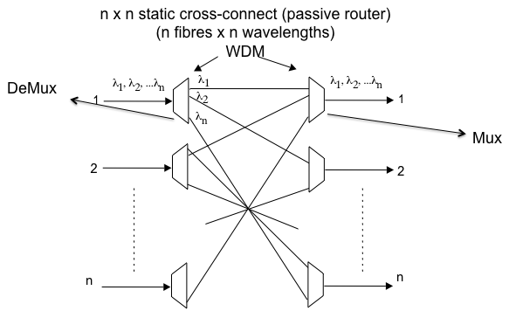
Static Cross Connect

Slide 19
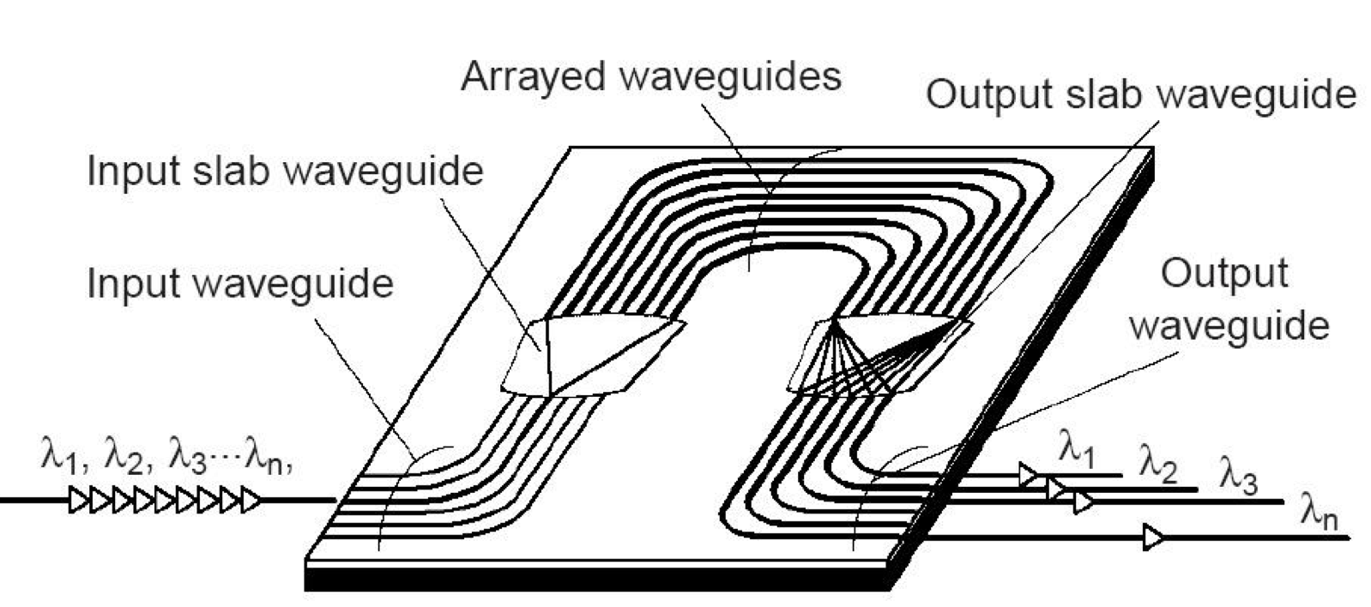
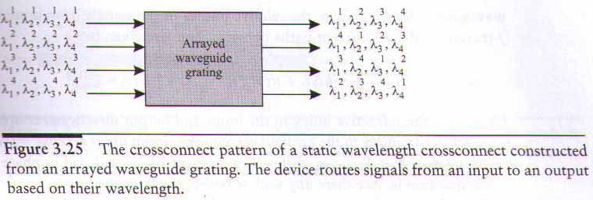
Static Cross Connect

Slide 20
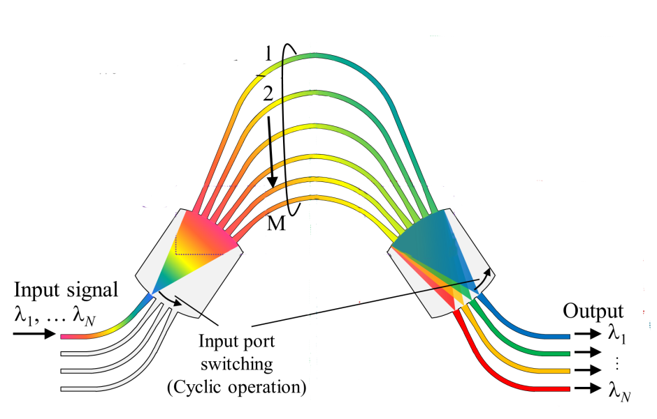
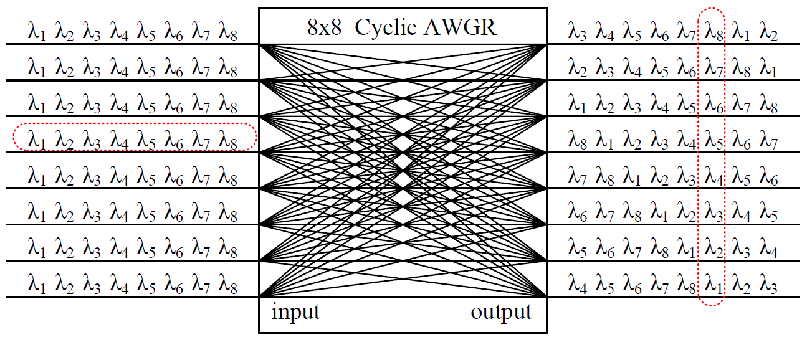
What about passive WDM routing?
Arrayed Waveguide Grating Router

Slide 21
What about passive WDM routing?
Arrayed Waveguide Grating Router
Cyclical freq. operation

Slide 22
What about passive WDM routing?
Arrayed Waveguide Grating Router
AWGR cyclic frequency operation allows bidirectional collision-less, buffer-less routing for any-to-any direct interconnection

Slide 23
Issues
Wavelength routing, where wavelength defines the path (route) through the network
Fixed routing does not give flexibility, need for switching
Needs for reconfigurable OADM/OXC
Next session:
Dynamic cross connects

